Slide 1
Software Construction – Session 2
Introduction to the class definition

Slide 2
Agenda
8.30 Recap from yesterday
Programming style
Starting with the ticket machine
9.30 Coffee break
9.50 Class definition
Start with exercises
11.30 Lunch break
12.00 “Treasure hunt”
13.00 The class definition
15.15 End the day

Slide 3
Recap From Previous Session
Classes
Define the way we describe objects (e.g.: “Cars have … properties”)
Objects
Instances of a class
Specific items from the real world, or from a problem domain (e.g.: “white Skoda Octavia”, “green Dacia 1310 TX”, etc.)
Attributes (fields, instance variable)
Information about objects / data stored in objects
Methods
Operations – for interaction with objects
(e.g. car.accelerateTo(70); )
Parameters
Data passed to methods – used locally, and/or stored in attributes
Return values
The method may return a “result” – e.g. calc.sum(1,2) → 3

Slide 4
Programming Style
Refer to Appendix J
Class names are singular nouns starting with a capital letter
Student, LabClass
Method and variable names start with lower-case letters
makeVisible, calculateVAT
Use meaningful names
Curly brackets follow the class/method/statement on the same line
Indentation is used to structure the code, it follows the nested blocks

Slide 5
Ticket Machine – Outside Perspective
Examine the behavior of the ticket machine
Open project Naïve-ticket-machine
Exercise 2.1 – 2.5

Slide 6
Ticket Machine – Inside Perspective
Interaction with an object provides clues about it’s behaviour.
Looking inside allows us to determine how that behaviour is provided or implemented.
All Java classes share the same structure

Slide 7
Basic Class Structure (Example)
The outer wrapper
of TicketMachine
public class TicketMachine {
Inner part of the class omitted.
}
Replace with your class’ name
Car
public class ClassName {
Attributes
Constructors
Methods
}
Customer
Fruit
ClassName
The contents of
a class

Slide 8
Fields = Attributes = Instance Variables
Attributes (fields) store values for an object
They are also known
as instance variables
Use BlueJ’s Inspect option
to view an object’s fields
Fields define the state
of an object
public class TicketMachine {
private int price;
private int balance;
private int total;
//Constructor and methods
//omitted.
}
visibility modifier
type
variable name
private int price;
Notes:
Exercise 2.11-2.14

Slide 9
What is the type of the following fields?
<visibility-modifier> <type> <variable-name> ;
private int count;
private Student representative;
private Server host;

Slide 10
What are the names of the following fields
<visibility-modifier> <type> <variable-name> ;
private boolean alive;
private Person tutor;
private MainCharacter bananaJoe;
10

Slide 11
Constructors
Constructors initialize an object
They have the same name as the class
They (may) assign initial values to the fields
They often receive external parameter values for this
Visibility modifier
Constructor name
Paramater
public TicketMachine(int ticketCost) {
price = ticketCost;
balance = 0;
total = 0;
}

Slide 12
Constructor Syntax
<constructor> ::=
<visibility-modifier> <name> ( <parameter-list> ) {
<statements>
}
<parameter-list> ::= ε | <parameter-decl> [, <paramater-decl> ]*
<parameter-decl> ::= <type> <name>
)
{
public
TicketMachine
(
ticketCost
int
price = ticketCost;
balance = 0;
total = 0;
}

Slide 13
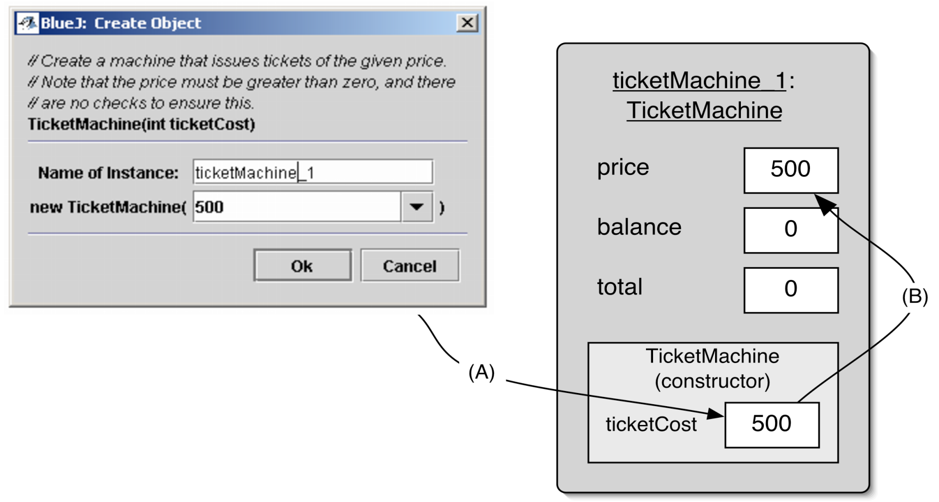
Passing Data Through Parameters
TicketMachine ticketMachine_1 = new TicketMachine(500);

Slide 14
Assignment
Values are assigned to fields (and other variables) via assignment statements:
<variable> = <expression>;
Example: price = ticketCost;
A variable stores a single value, so any previous value is ‘forgotten’

Slide 15
Valuation (Semantics)
Values are stored into fields (and other variables) via assignment statements:
<variable> = <expression>;
Example: price = ticketCost;
What happens here??
ticketCost = 5;
ticketCost→?
ticketCost→5
price = ticketCost;
price→? ticketCost→5
price = 5 ;
price→? ticketCost→5
price→5 ticketCost→5

Slide 16
Valuation Exercise (Semantics)
<variable> = <expression>;
Example: price = unitPrice * count;
Assume: unitPrice = 11, count = 5
price = unitPrice * count;
price→?
unitPrice→11
count→5
price = 11 * count;
price→?
unitPrice→11
count→5
price = 11 * 5 ;
price→?
unitPrice→11
count→5

Slide 17
Valuation Exercise (Semantics)
price = 11 * 5 ;
price→?
unitPrice→11
count→5
price = 11 * 5 ;
price→?
unitPrice→11
count→5
price = 55 ;
price→?
unitPrice→11
count→5
price = 55 ;
price→55
unitPrice→11
count→5

Slide 18
Valuation Exercise – Differently (Semantics)
price
=
55
11
5
price = unitPrice * count;
price→?
unitPrice→11
count→5
price→55
unitPrice→11
count→5

Slide 19
Passing Data Through Parameters
TicketMachine ticketMachine_1 = new TicketMachine(500);

Slide 20
Passing Data Through Parameters
TicketMachine ticketMachine_1 = new TicketMachine(500) ;
500
500
price→?
balance→?
total→?
ticketCost→?
public TicketMachine(int ticketCost) {
500
500
price = ticketCost;

Slide 21
Accessor Methods (get())
Methods implement the behaviour of objects
Accessors provide information about an object
Methods have a structure consisting of a header and a body
The header defines the method’s “signature”
public int getPrice()
The method body contains the method’s statements
visibility modifier
return type
method name
parameter list (here: empty)
public int getPrice()
{
return price;
}
return statement
start and end of method body (block)

Slide 22
Naming Convention For Getters
get + VariableName
E.g.: public int getAge() {…}
E.g.: public String getName() {…}
EXCEPT for booleans:
is + VariableName
E.g.: public boolean isAdult() {…}

Slide 23
Accessor Methods (get-syntax)
<accessor> ::=
<visibility-modifier> <return-type> <name> ( ) {
<statements>
}
<statements> ::= <return-stmt> | <statement><statements> | …
<return-stmt> ::= return <expression> ;
getPrice
public
int
()
{
return
price
;
}

Slide 24
Mutator Methods (set())
Have the standard method structure: header and body
Used to “mutate” (i.e., change) an object’s state
Achieved through changing the value of one or more fields
Typically contain assignment statements
Typically receive parameters
visibility modifier
return type (void)
method name
parameter
public void insertMoney(int amount){
balance += amount;
}
assignment statement
field being changed

Slide 25
Mutator Methods (set())
<mutator> ::=
<visibility-modifier> void <name> (<parameter-decl> ) {
<statements>
}
public void insertMoney(int amount){
balance += amount;
}

Slide 26
Naming Convention For Setters
set + VariableName
E.g.: public void setAge(int newAge) {…}
E.g.: public void setName(String n) {…}
No exceptions

Slide 27
Printing to the console
public void printTicket() {
// Simulate the printing of a ticket.
System.out.println("##################");
System.out.println("# The BlueJ Line");
System.out.println("# Ticket");
System.out.println("# " + price + " cents.");
System.out.println("##################");
System.out.println();
// Update the total collected with the balance.
total = total + balance;
// Clear the balance.
balance = 0;
}

Slide 28
Reflecting on the Ticket Machines
Their behaviour is inadequate in several ways
No checks on the amounts entered
No refunds
No checks for a sensible initialization
How can we do better?
We need more sophisticated behaviour
What kind of error
are we talking about?

Slide 29
Decision Structures
public void insertMoney(int amount){
if(amount > 0) {
balance += amount;
}
else {
System.out.println("Use a positive amount: " +
amount);
}
}

Slide 30
Decision Structures
boolean condition - gives a true or false result
‘if’ keyword
actions if condition is true
if(perform some test) {
Do the statements here if the test gave a true result
}
else {
Do the statements here if the test gave a false result
}
actions if condition is false
‘else’ keyword

Slide 31
IF statement
if (count == 0){
System.out.println(”No values were
entered.”);
}
else {
double average = sum/count;
System.out.println(”The average is ”
+ average);
}

Slide 32
Nested if Statement
if (code == ’R’){
if (height <= 20) {
System.out.println(”Situation normal”);
}
else {
System.out.println(”Bravo!”);
}
}
It may be better to make a method if you get too many nested if statements

Slide 33
Variable Types
Instance variables (also called attributes and fields)
Describes the attributes of an object, and are accessible from the entire class
Same scope as the object (value is stored as long as the object exists)
Local variables
Used temporarily within the method, and is thus only accessible from inside the method where it was declared.
A local variable
public int refundBalance(){
int amountToRefund;
amountToRefund = balance;
balance = 0;
return amountToRefund;
}
No visibility
modifier
The variable’s value is returned

Slide 34
Variables - Syntax
<attribute> ::= <visibility>? <variable-decl> ;
<visibility> ::= public | private | protected
<variable-decl> ::= <type> <identifier>
<type> ::= int| long | double | float | boolean | …
| <class-identifier>
Variable identifiers: start with lowercase initial letter (a variable name)
Class identifier: start with uppercase initial letter (a class name)
private int x;
boolean happy;
private int age;
private long millisec;
private long millisec;
private Student s;
private double price;
public String name;

Slide 35
Data Types
A data type is characterized by
A set of values (which the data type accepts)
Data representation (how are the values stored)
A set of operations (the operations applicable to the data type)
Consider int, String, TicketMachine
Two main categories exist
Primitive types (e.g. int, long, boolean, char, etc.)
Object types (Strings, references to objects in general)

Slide 36
Data Types in Java
Data Type | Default Value (for fields)
byte | 0
short | 0
int | 0
long | 0L
float | 0.0f
double | 0.0d
char | '\u0000'
String (or any object) | null
boolean | false
https://docs.oracle.com/javase/tutorial/java/nutsandbolts/datatypes.html

Slide 37
Summary
Class bodies contain fields, constructors, and methods.
Fields store values that determine an object’s state.
Constructors initialize objects.
Methods implement the behaviour of objects.
Fields, parameters and local variables are all variables.
Fields exists for the lifetime of an object.
Parameters are used to pass values into a constructor or method.
Local variables are used for short-lived temporary storage.
A “true or false test” allows one of two alternative courses of actions to be taken. (Conditional statement if)

Slide 38
Exercises
Native Ticket Machine
Solve exercises:
2.23 – 2.29 methods experiments
2.30 - test
2.31 – 2.32 new method setPrice()
2.37 – 2.42 add print methods
2.43 – 2.45 improvements
Better Ticket Machine:
2.46 – 2.51 if
2.58 – 2.63 local variables
Session02Exercises (is on eCampus under session02)

